Slide 1
Automated Vehicle Anti-Theft Security System
Group 15
Adam Hadiji-Electrical Engineering
Sean Perraud-Electrical Engineering
Gerardo Pineda-Computer Engineering
Benjamin Hochstadt-Computer Engineering

Slide 2

Project Motivation
To improve on dash-cam features already on the market
To lower the risk of vehicle break-ins and theft
  There were an estimated 721,000 thefts of motor vehicles nationwide in 2012*
Safeguard against the risk of fraud
*Source: FBI: Crime in the United States 2012

Slide 3
Project Goals
Full visual coverage of vehicle
Full mobile integration
Solar powered
Low power usage
Alerts user of security breach
Repel potential intruders through an alarm system
Notes:
*talk about the full mobile integration

Slide 4
Requirements and Specifications
Device fits securely on top of vehicle being no larger than 50” x 30” x 8”.
4 independent cameras.
Both motion and vibration detection used.
Detects up to 2m away.
Sends alerts and video feed.
30 second response time.
Easy-to-use minimal interface for the application.
Ward intruder with an alarm.
12-V battery to power system, with a battery cycle life of 18 hours.
Solar Powered.

Slide 5
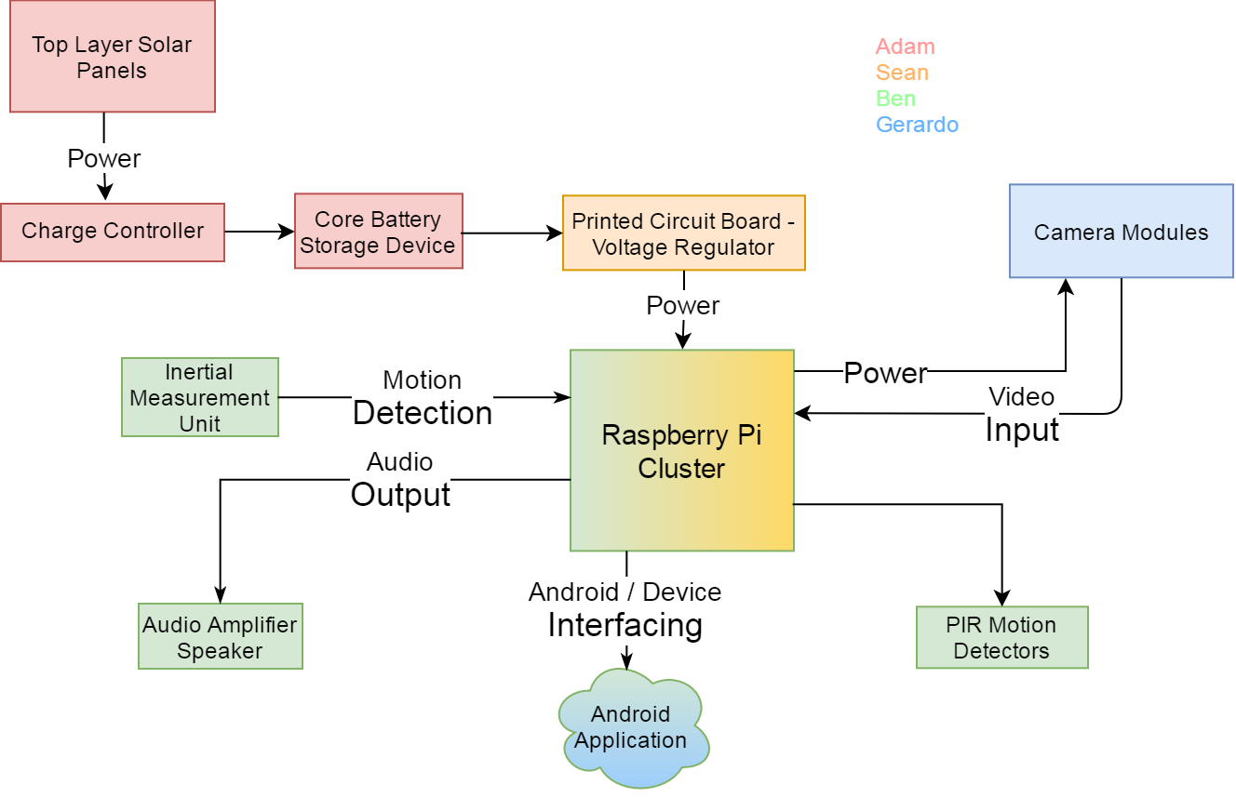
Overall System Design

Slide 6
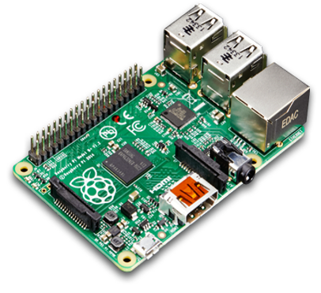
Microcontroller
Board Name | Arduino Mega 2560 | Raspberry Pi 3
CPU | 16 MHz ATmega 328P | 1.2 GHz Quad-core ARMv8
RAM | 8 kB | 1 GB
Storage | 256 kB Flash | MicroSD
Network | N/A | 10/100 Ethernet, 802.11n/Bluetooth 4.0
USB ports | 1 | 4
GPIO | 54 x Digital I/O, 15x PWM digital, 16 x Analog | 40 x GPIO pins
Operating Voltage | 5V | 5V
Power source | USB or 2.1mm jack | Micro-USB or pins
Size | 101.52mm x 53.3 mm | 85.6mm x 56mm x 21mm
Bit | 32-bit | 64-bit
Weight | 37 g | 45 g
Price | $46 | $35
Advantages
Quad-core processor
MicroSD storage
Built-in wireless capabilities
Price

Slide 7
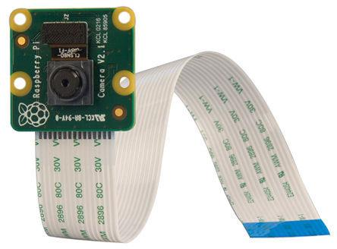
Camera
Camera Model | Camera Module v2 | ELP-USB500W02M-L21
Frame Rate | 30-60 fps | 30 fps
Megapixel count | 8 Megapixel | 5 Megapixel
Display Resolution | 1280 x 720 @ 60fps 1920 x 1080 @ 30fps | 1280 x 720 @ 30 fps
Focal Length | 3.6 mm | 2.1mm
Operating Voltage | 5 V | 5 V
Power Source | 15 cm Ribbon Cable | USB BUS
Size | 25mm x 24mm | 38mm x 38mm
Weight | 3g | 30g
Cost | $25 | $43
Advantages
More megapixels for better quality
A high display resolution and playback framerate
Easy to use with Raspberry Pi
Price

Slide 8
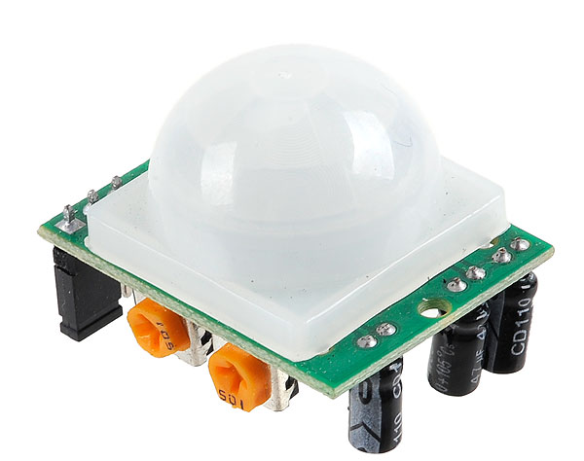
Motion Sensor
Sensor Type | Function | Advantage | Disadvantage
Ultrasonic | Sound Pulse | Determine distance | Active power
Microwave | Electromagnetic Field | Works in any temperature | Expensive
Continuous | Electromagnetic Field | Works in any Temperature | Expensive
Image Processing | Video Feed | Very accurate | Active Power and Cost
PIR | Infrared Light | Passive power | Less accurate

Slide 9
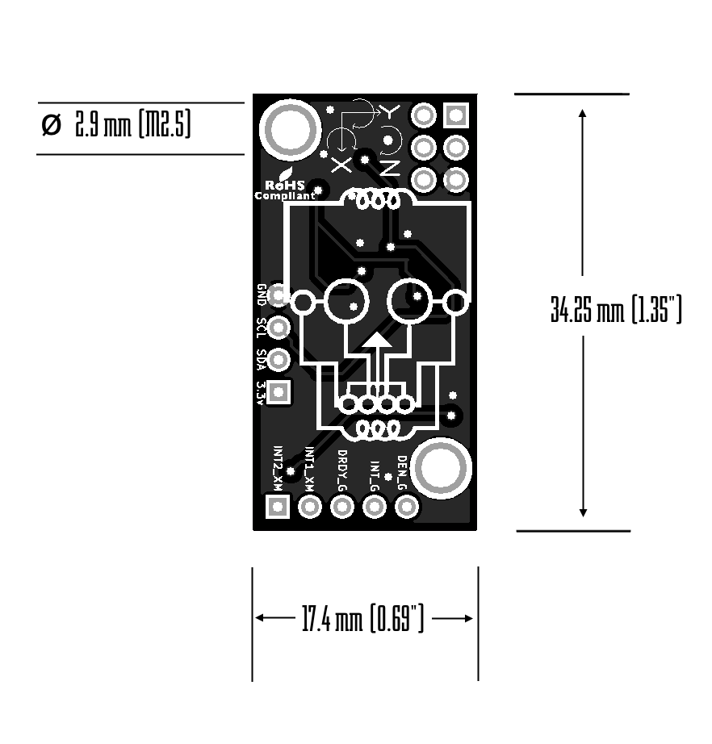
Inertial Measurement Unit
IMU Model | BerryIMU | BMI160 Shuttle Board
Supply Voltage | 3.3 V | 1.2 – 3.6 V
Acceleration | ±2g, ±4g, ±6g, ±8g, ±16g | ±2g, ±4g, ±8g, ±16g
Axes | 6-axis | 6-axis
Output Type | Digital | Digital
Size | 17.4 mm x 34.25 mm | 20.32 mm x 43.18 mm
Price | $25 | $37.50
IMU containing an accelerometer and a gyroscope
Gyroscope to measure angular velocity
Accelerometer to measure acceleration forces
Used for after initial motion detection
Determines if someone is attempting to break-in

Slide 10
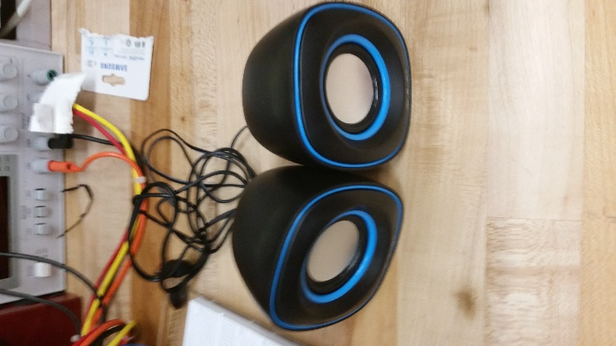
Audio Speakers
Raspberry Pi has low power output for audio jack
USB powered speaker preferable
Produce loud and clear audio
Cost efficient
Model | USB HP-1800 | Logitech Z-130
Operating Voltage | 5 V | Low
Frequency Response | 100 Hz – 18 kHz @ 3Watts | 80 Hz – 18 kHz @ 5 W-10 W max
Impedance | 4 Ohm | ≈8 Ohm
Sensitivity | ≈83-87 dB | 88 dB
Dimension | 69mm x 80mm x 85mm (One Speaker) | 86mm x 232mm x 116mm (One Speaker)
Price | $10 | $16.68

Slide 11
Pi Cluster
The PCB supplies power to the switch as well as each of the Raspberry Pi’s.
Centralized Ethernet switch connected to each Pi nodes via Ethernet cable.
A GSM module is connected to the head node to provide access to text message alerts.
Each Pi has access to their respective camera module and PIR sensor
Notes:
Discuss why we did a pi cluster
Starting at the top we have our voltage regulator which feeds power into each of the Pi’s as well as the Ethernet switch.
The switch is connected to each of the Pi’s via an Ethernet cable. They will then have the ability to interface with one another by referencing their respective local IP address.
At the head node we have a GSM module attached which will allow us to send text message alerts to the user.
And finally each of our Pi nodes has access to their respective camera module and PIR sensor. When the camera is active and recording, the video data is then saved on the Pi’s local storage.

Slide 12
Charging System
Solar Panel
100 watt solar panel
  Flexible
charge controller PCB
12 volt Sealed Lead Acid Battery
12 volt to 5 volt DC to DC converter
Charge Controller
Battery
DC to DC Converter
Load

Slide 13
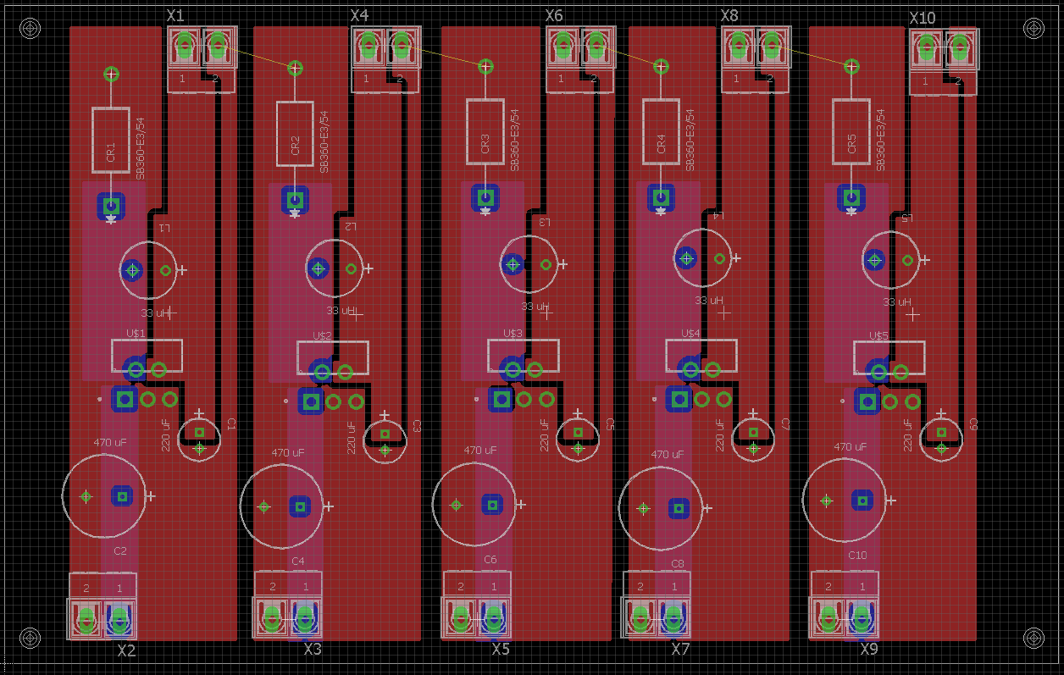
First PCB design
Eagle
Need 5 volt power supply for load
Switching Regulators
Input/Output ports
Trace thickness

Slide 14
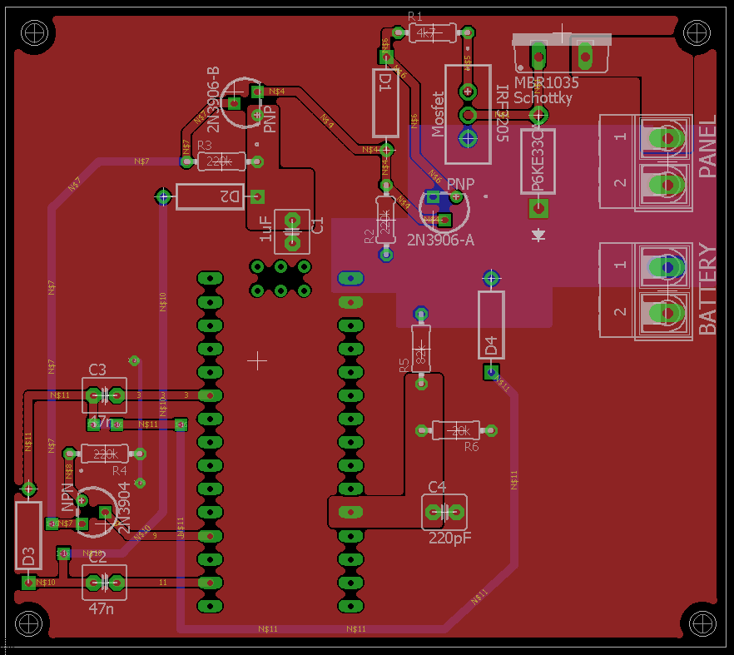
Second PCB design
PWM Charge Controller
Connects to Solar panel and battery
Overcharge protection
Reverse current protection
Nano Arduino

Slide 15
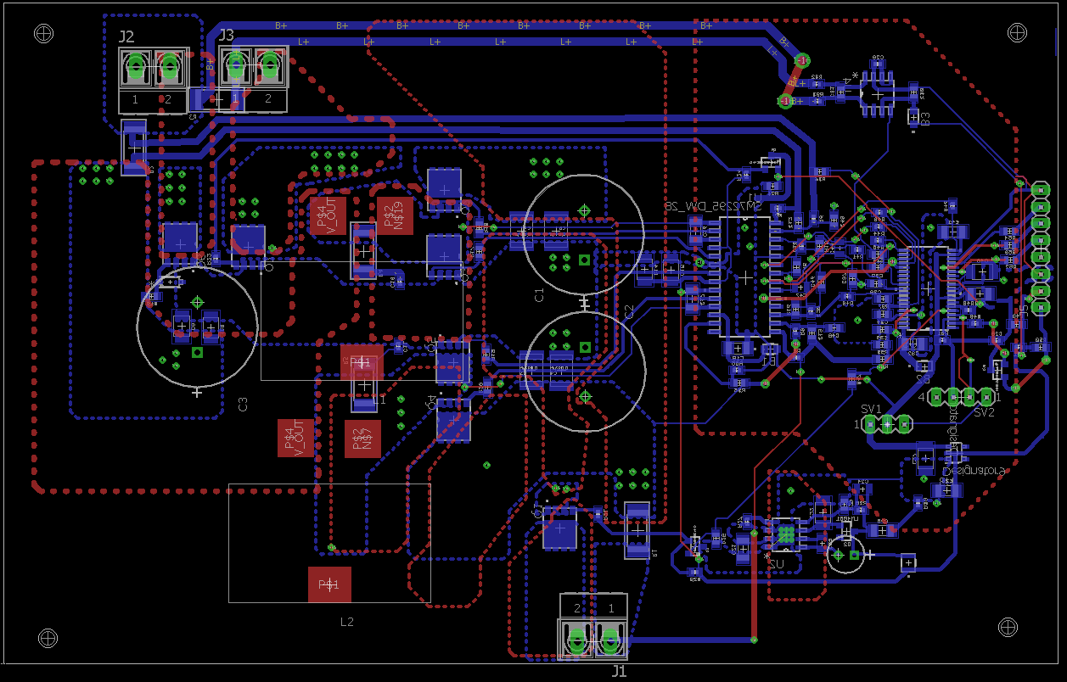
Attempted PCB design
MPPT Charge Controller
Connects to Solar panel and battery and load
Embedded MSP430 programming
Inconsistencies/problems

Slide 16


Android Application
Programmable on any OS
Open Source
Android Studio IDE
  Java
  Android Emulator Feature

Slide 17
Use Case Diagram

Slide 18
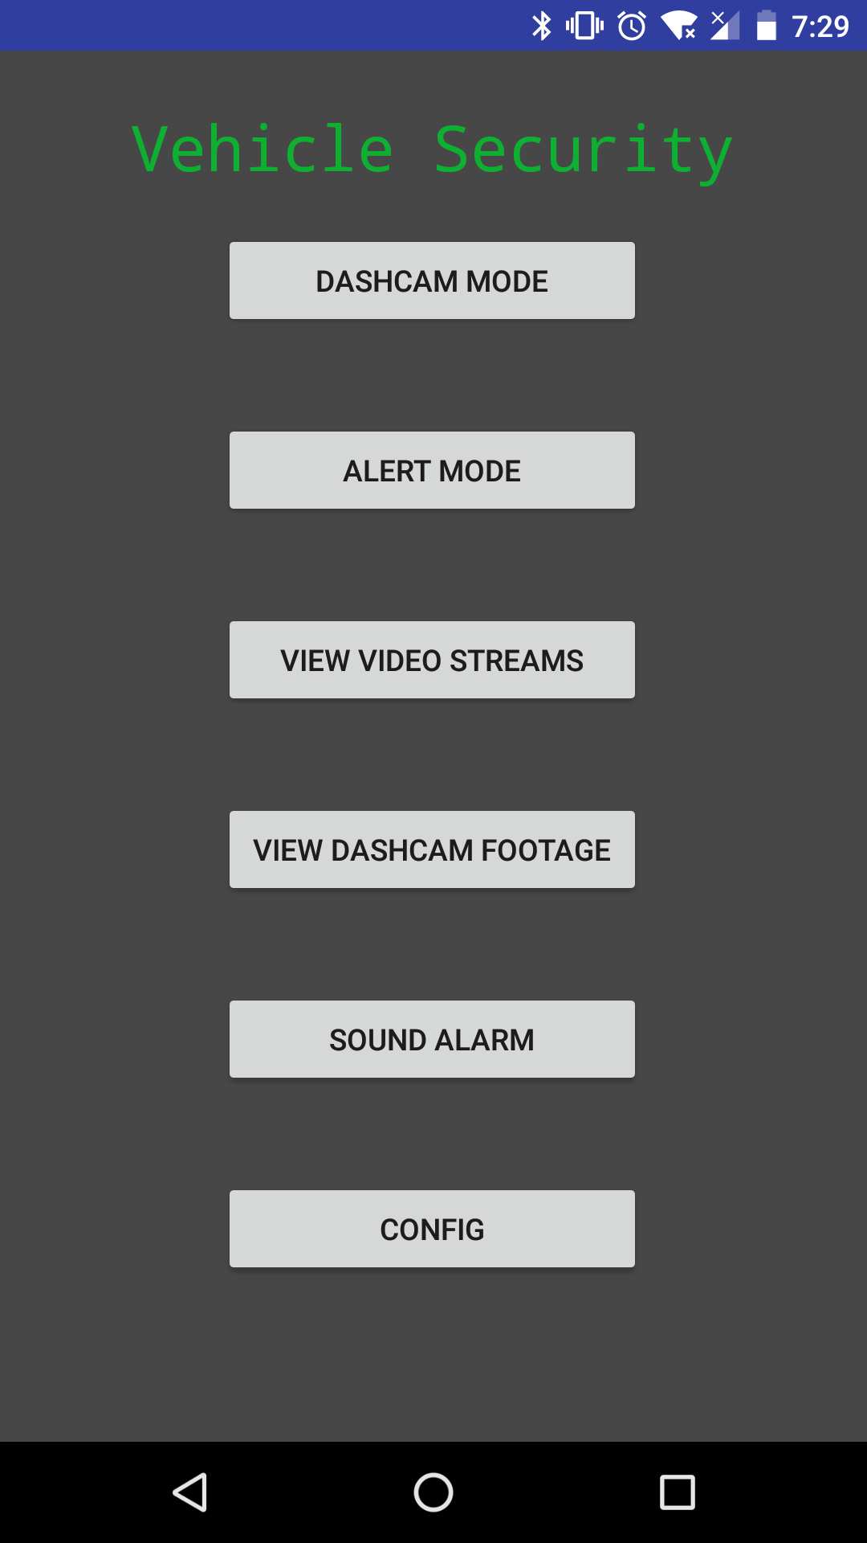
Mobile Application Features
Allows users to:
  Select Operation Mode
  View Video Streams
  View Directories
  Receive Notifications
  Send Alert to System
  Configure Settings

Slide 19
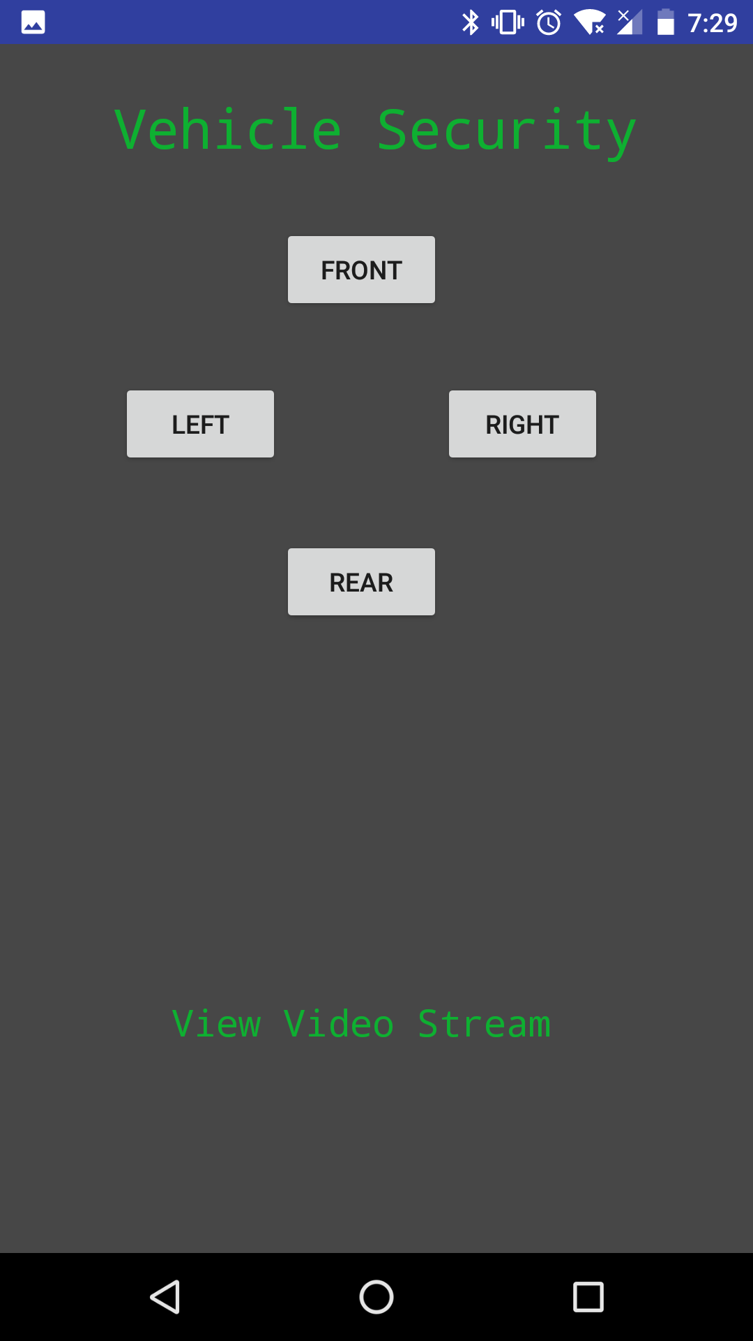
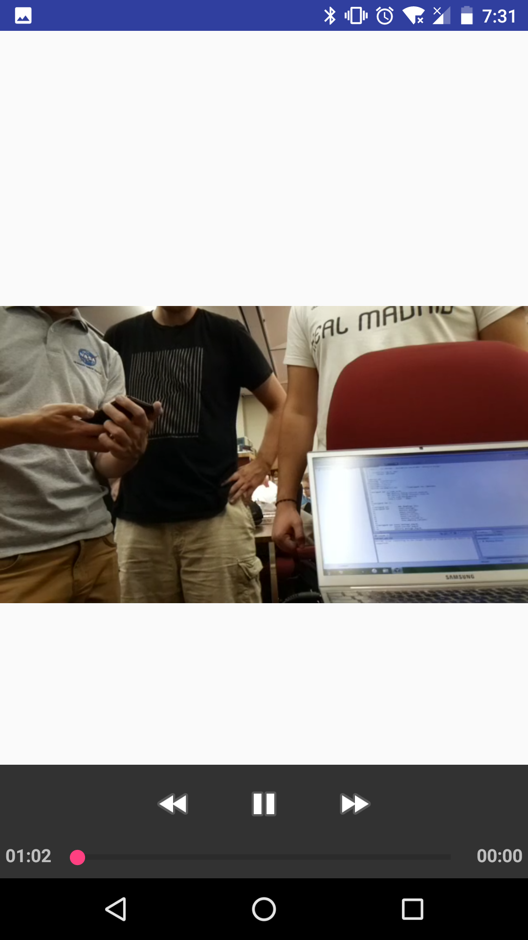
Notes:
Fix Pictures make one of alert System as well

Slide 20
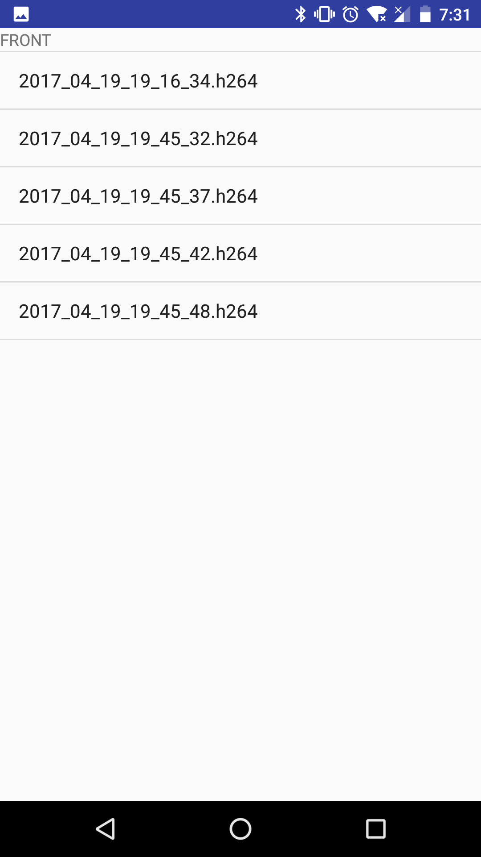
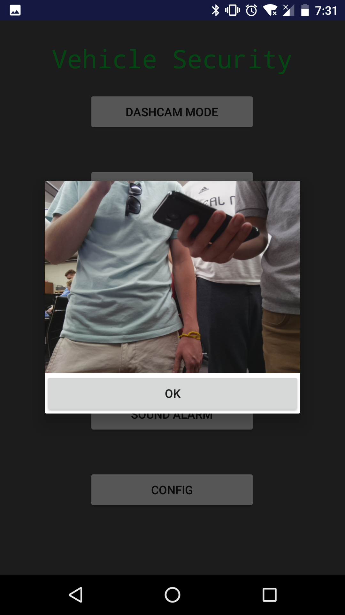
Notes:
Fix Pictures make one of alert System as well

Slide 21
Pi Cluster – Communication and Synchronization
System moding is sustained by a configuration file, containing flags of operation.
The Head Pi defines core system settings such as dashcam clip length.
Interfacing sequences will halt based on flag values, and terminate upon interrupt flags.
Head Pi carries out commands to other Pi’s via SSH and automated Expect scripts, handling the distribution of tasks and data.
Notes:
For the Pi Cluster, we need a way to control the multiple processors that we have available to us.
What we’ll be using is MPICH, an implementation of MPI, which is the Message Passing Interface. MPI is a standardized library which provides core routines that would allow the head node to dictate tasks down to the other worker nodes.
On top of that we’re using MPI4PY which will let us run Python code in that same fashion.

Slide 22

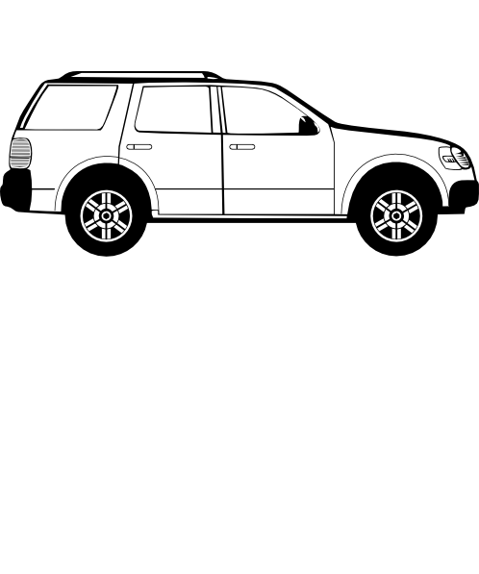
Device Communication
3G USB Modem to provide text message access.
  Available anywhere there is cellular reception.
  After initial setup, the device can handle automatic connection on powerup.
Apache2 Web Server, PHP, and MySQL database for mobile Android device interfacing.
Mobile application will call HTTP requests to onboard PHP scripts hosted on the Head Pi’s Apache2 Web Server.

Slide 23
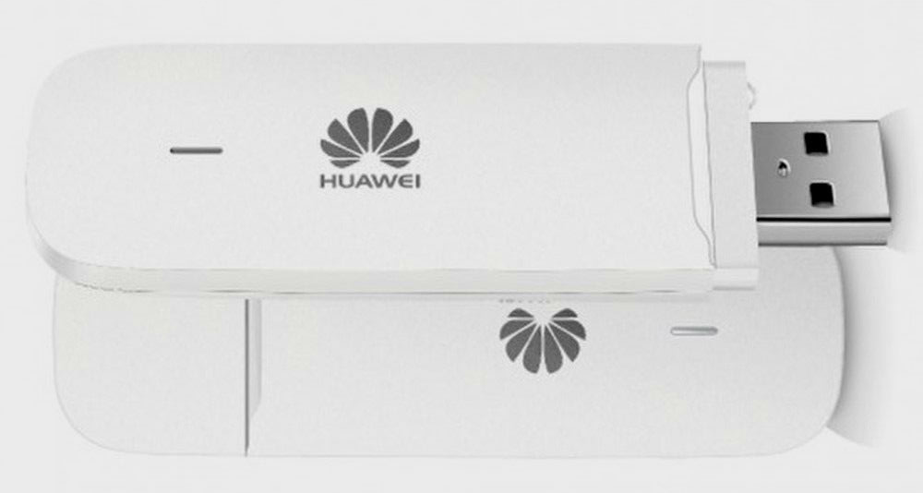
3G USB Modem
Model | Huawei E3531s | Vodafone K3772
Supported GSM Frequency Bands | 850/900/1800/1900/2100 | 900/1800/1900
Storage Expansion | None | MicroSD up to 32 GB
Max Transfer Rate | Up to 21 Mbps | 7.2 Mbps
Price | $23.00 | $19.00
Huawei E173 supports an additional frequency band as well as MicroSD card expansion.
Negligible pros over the Vodafone K3772, no need to additional onboard storage or wider frequency range.
Biggest factors being price and transfer speed.

Slide 24

Video Streaming to Android
Live Stream
  Raspivid Command
  VLC Player
DashCam Videos
  MP4Box
Notes:
Raspivid Command that came with the raspbian OS.
raspivid | VLC Viewer encode and stream it to our desired port.
Android app listen and display the video from that port
Using raspivid command video is saved as .h264
.h264
MP4Box -> .mp4 hosted on webserver android did HTTP request, and plays videofile.

Slide 25
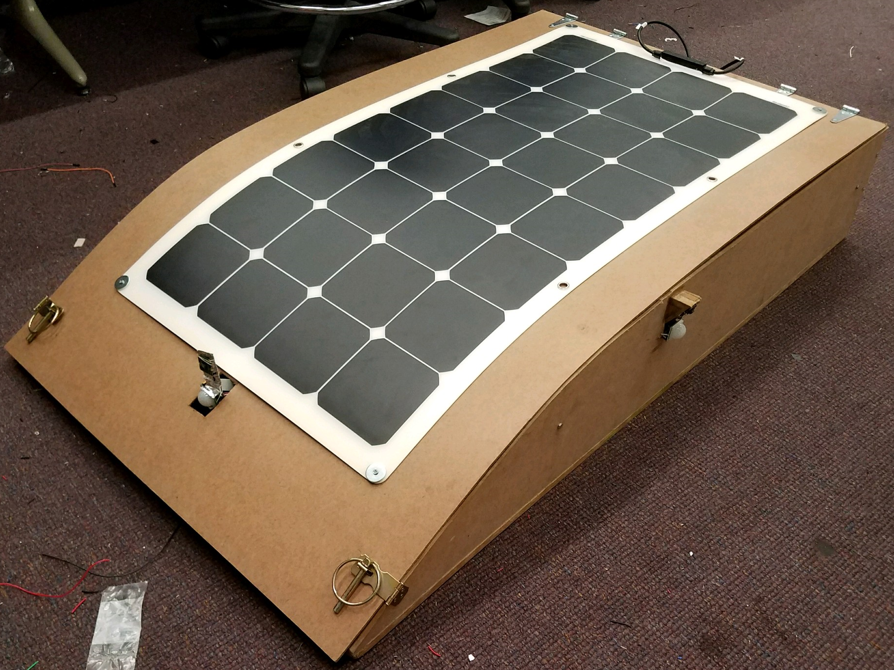
Overall System Design
Wooden Chassis
Curved top design
Centralized design
Metal framing inside

Slide 26
Work Distribution
 | Solar Power | PCB Design | Pi Cluster | Device Communication
Adam | Primary | Secondary
Sean | Secondary | Primary
Ben |  |  | Primary | Secondary
Gerardo |  |  | Secondary | Primary

Slide 27
Budget
Item | Price/Unit | Units | Total Cost
Suaoki Solar Panel Charger | $169.99 | 1 | $169.99
12v 10 Ah SLA Rechargeable Battery | $26.99 | 1 | $26.99
Sabrent Premium 3ft Micro USB Cables | $9.99 | 1 | $9.99
Solar Panel Cable Connectors | $6.99 | 1 | $6.99
Raspberry Pi Model 3 B | $35.69 | 4 | $142.76
Huawei Mobile Broadband Dongle | $19.95 | 1 | $19.95
Sensors | $10 | 1 | $10.00
Raspberry Pi Camera Module V2 | $24.99 | 4 | $99.96
SD Card | $13.73 | 4 | $54.92
USB Powered Speakers | $18.53 | 1 | $18.53
BerryIMU | $25.00 | 1 | $25.00
PCB Design & components | $300.00 | 1 | $300.00
Ethernet Hub | $10 | 1 | $10.00
Chassis | $70 | 1 | $70
Expected Cost |  |  | $750
Total |  |  | $965.08

Slide 28
Potential Improvements
Connect application and system to Web Service
Improve Chassis
Improve Video Stream Delay

Slide 29
Questions?

